Slide 1

Accidental Drug Related Deaths

Slide 2
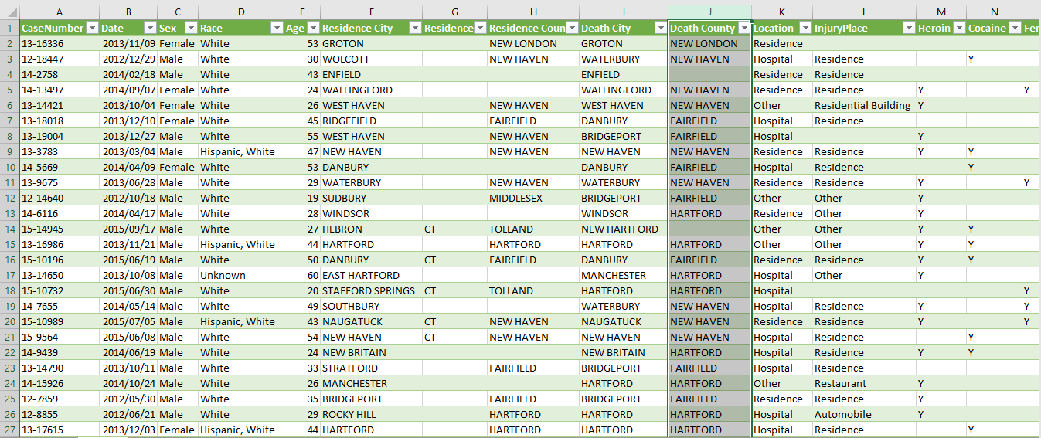

Slide 3
Background
This dataset consisted of a listing of each accidental death associated with drug overdose in Connecticut from 2012 to June 2017.
It contains information such as the death case number, date, sex, race, age, residence of the deceased, where they died, the location and injury place and the different types of drugs that caused the deaths.
All deaths that occurred were accidental.

Slide 4
Demographics

Slide 5
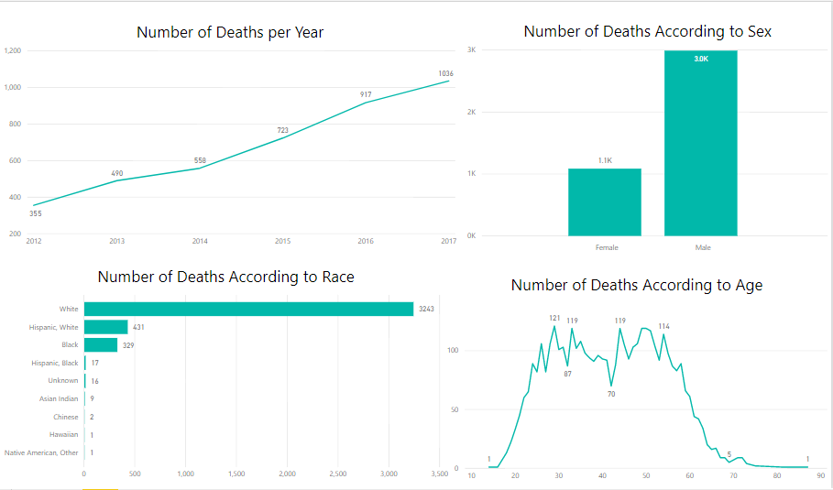

Slide 6
Conclusion
As the years increased from 2012 – 2017, more accidental drug related deaths occurred
There were 3 times more male that had accidental deaths than females
Most deaths occurred were among white and Hispanic whites, followed by Blacks and Hispanic blacks
Most deaths occurred between the ages of 26 – 35 and 43 – 54

Slide 7
Origin of Death

Slide 8
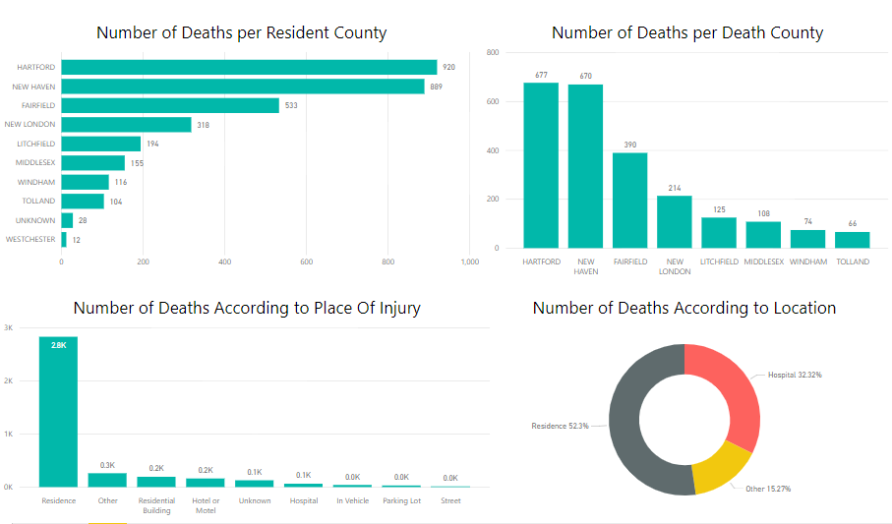

Slide 9
Conclusion
The most deaths that occurred were among people that resided in Hartford, New Haven and Fairfield
Most deaths that occurred were also in Hartford, New Haven and Fairfield
The place that had the highest number of injuries occurred in the deceased’s residence
Most deaths occurred in the deceased’s residence, followed by the hospital and lastly somewhere else

Slide 10
Which Drug Caused the Most Deaths?

Slide 11
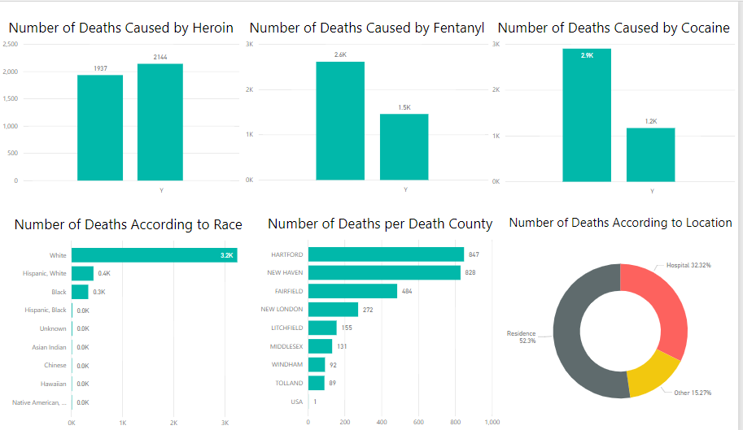

Slide 12
Conclusion
Most deaths were caused by Heroin, followed by Fentanyl and then Cocaine
Most Deaths according to each race were also because of Heroin first, followed by Fentanyl and then Cocaine
Most Deaths according to each death county were also because of Heroin first, followed by Fentanyl and then Cocaine
And lastly, the most deaths according to each drug happened at the residence, then the hospital and the least of the deaths occurred somewhere else

